Slide 1

AI Agents
Thinking and Doing - Recent Work on Reasoning Models, Test-Time Scaling, AI Agents, and Agentic AI
Notes:
Lecture: 70mins + 20mins discussion! → ~35 Slides = 7 slides (~14min) / person
Deadline: 2025-07-17
build structure around an example
APA references on slides (with link to arxiv)

Slide 2
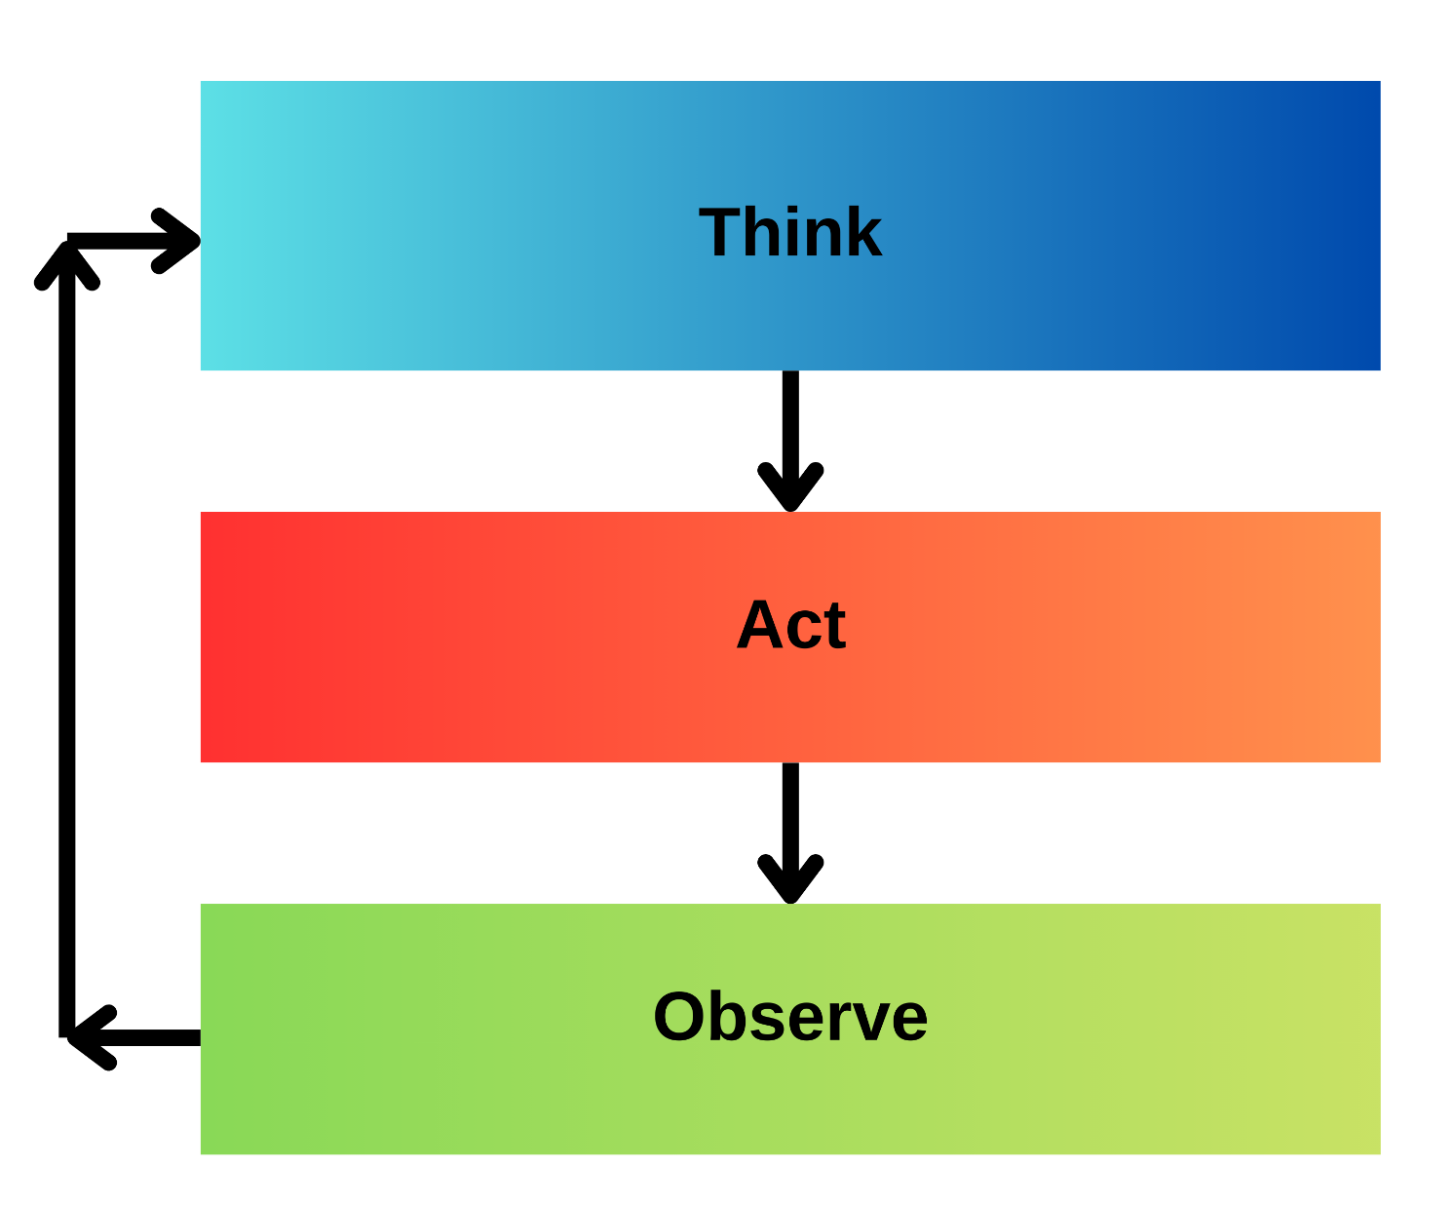
ReAct [Reasoning + Acting]
Loop:
1. Send prompt to LLM
2. LLM replies with text output (may include Thought, Action, or Answer)
3. Display or record LLM output
4. If output contains "Action:" then:
Extract the action command from output
Execute the action (e.g., run search or query)
Get the observation result from action execution
Append the LLM output and the observation to the prompt
5. Else if output contains "Answer:" then:
This is the final answer
Stop the loop
6. Else:
Append the LLM output to the prompt
Continue the loop
End loop
Yao, S. et al. (2023) ‘ReAct: Synergizing Reasoning and Acting in Language Models’. arXiv. Available at: https://doi.org/10.48550/arXiv.2210.03629.

Slide 3
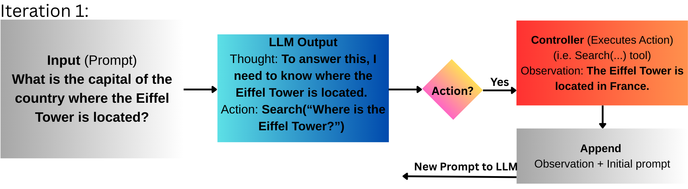
Prompt = "What is the capital of the country where the Eiffel is Located?”
How would ReAct tackle this?

Slide 4
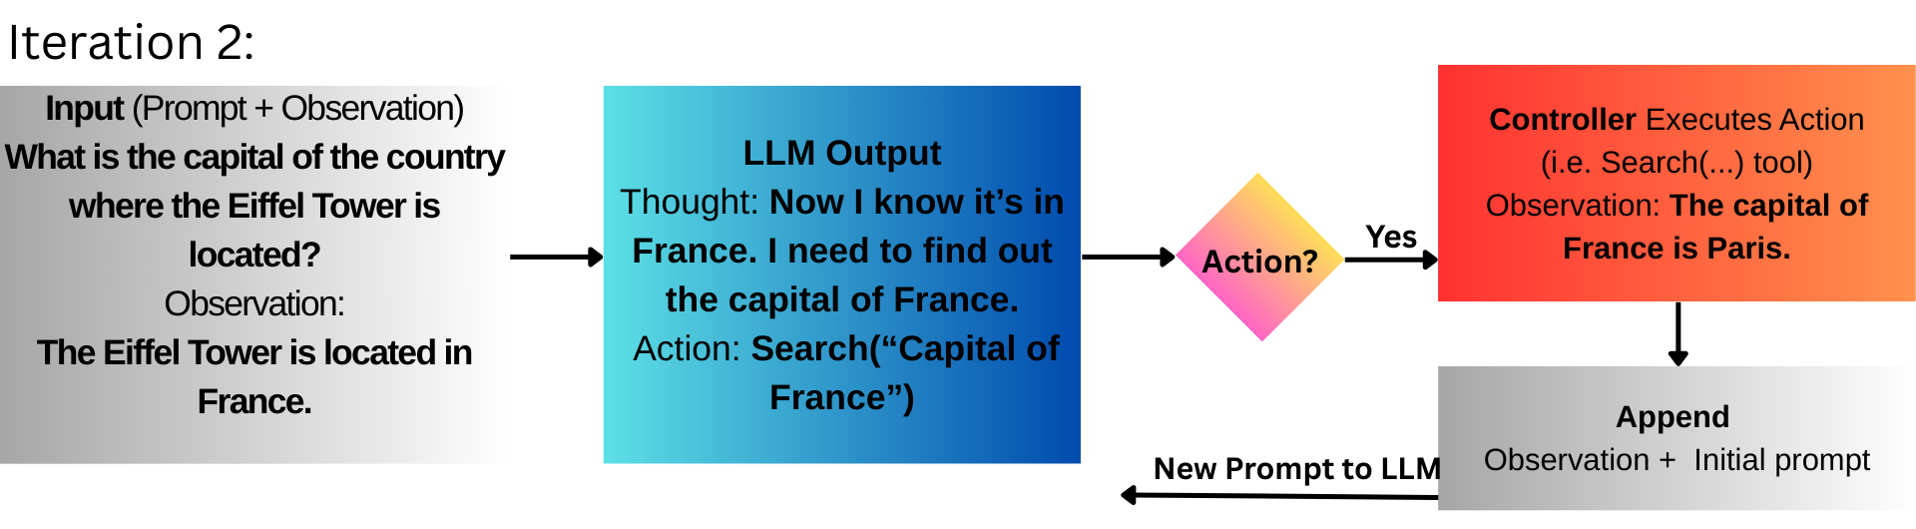
The LLM has new information to work with. Initial prompt + the new fact.

Slide 5
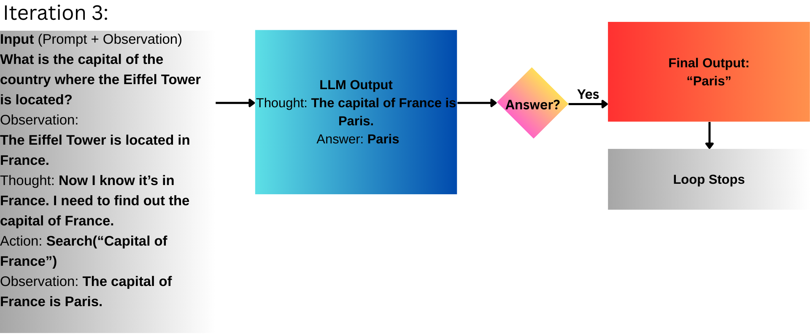
Then finally the LLM has all the pieces. It makes a final thought.

Slide 6
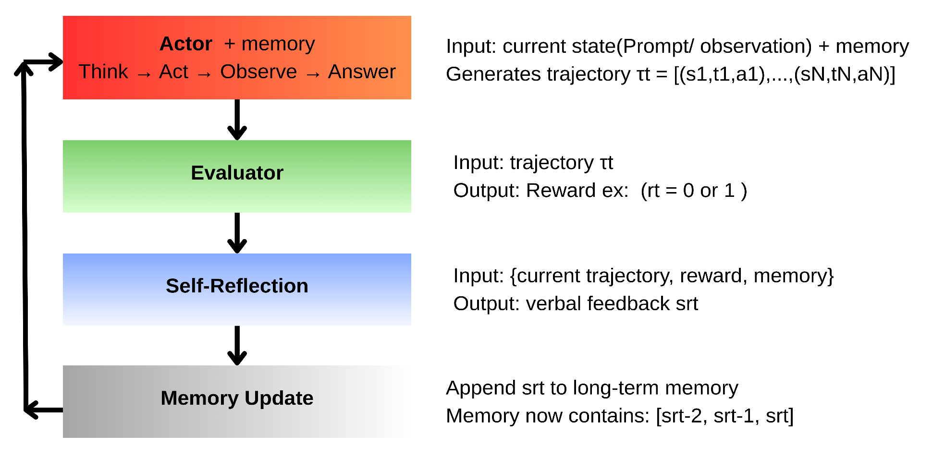
Reflexion
Shinn, N. et al. (2023) ‘Reflexion: Language Agents with Verbal Reinforcement Learning’. arXiv. Available at: https://doi.org/10.48550/arXiv.2303.11366.

Slide 7
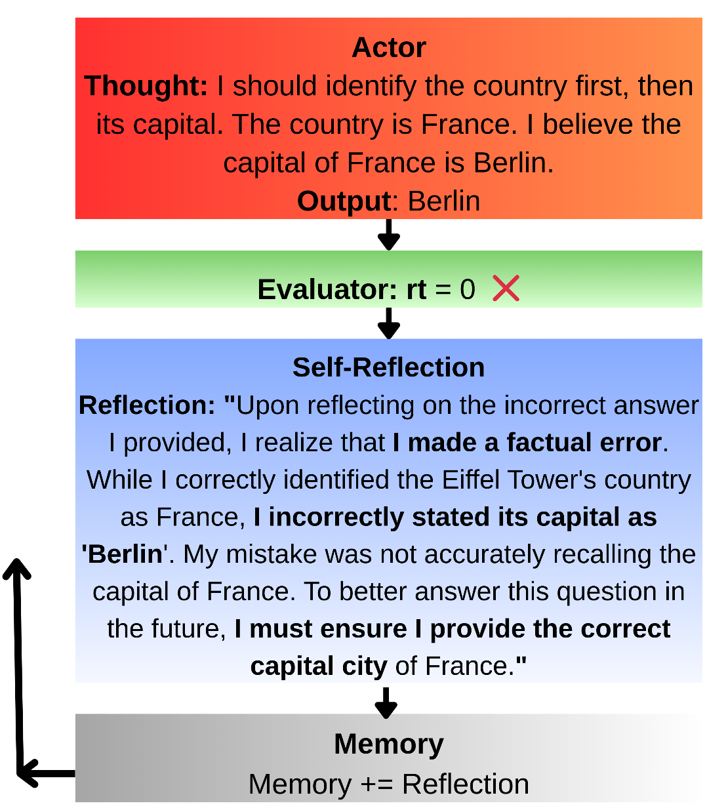
Reflexion
Trial 0:
INPUT: task
LOOP:
Actor receives prompt and memory
Actor THINKS, ACTS, OBSERVES repeatedly
Actor outputs a trajectory ending with a final answer
Evaluator compares Actor’s answer with correct answer
IF Evaluator score (rt) is 1 (correct):
SHOW final answer
EXIT loop
ELSE #score is 0 (Fail)
Self-Reflection generates feedback
Append feedback to memory
CONTINUE loop

Slide 8
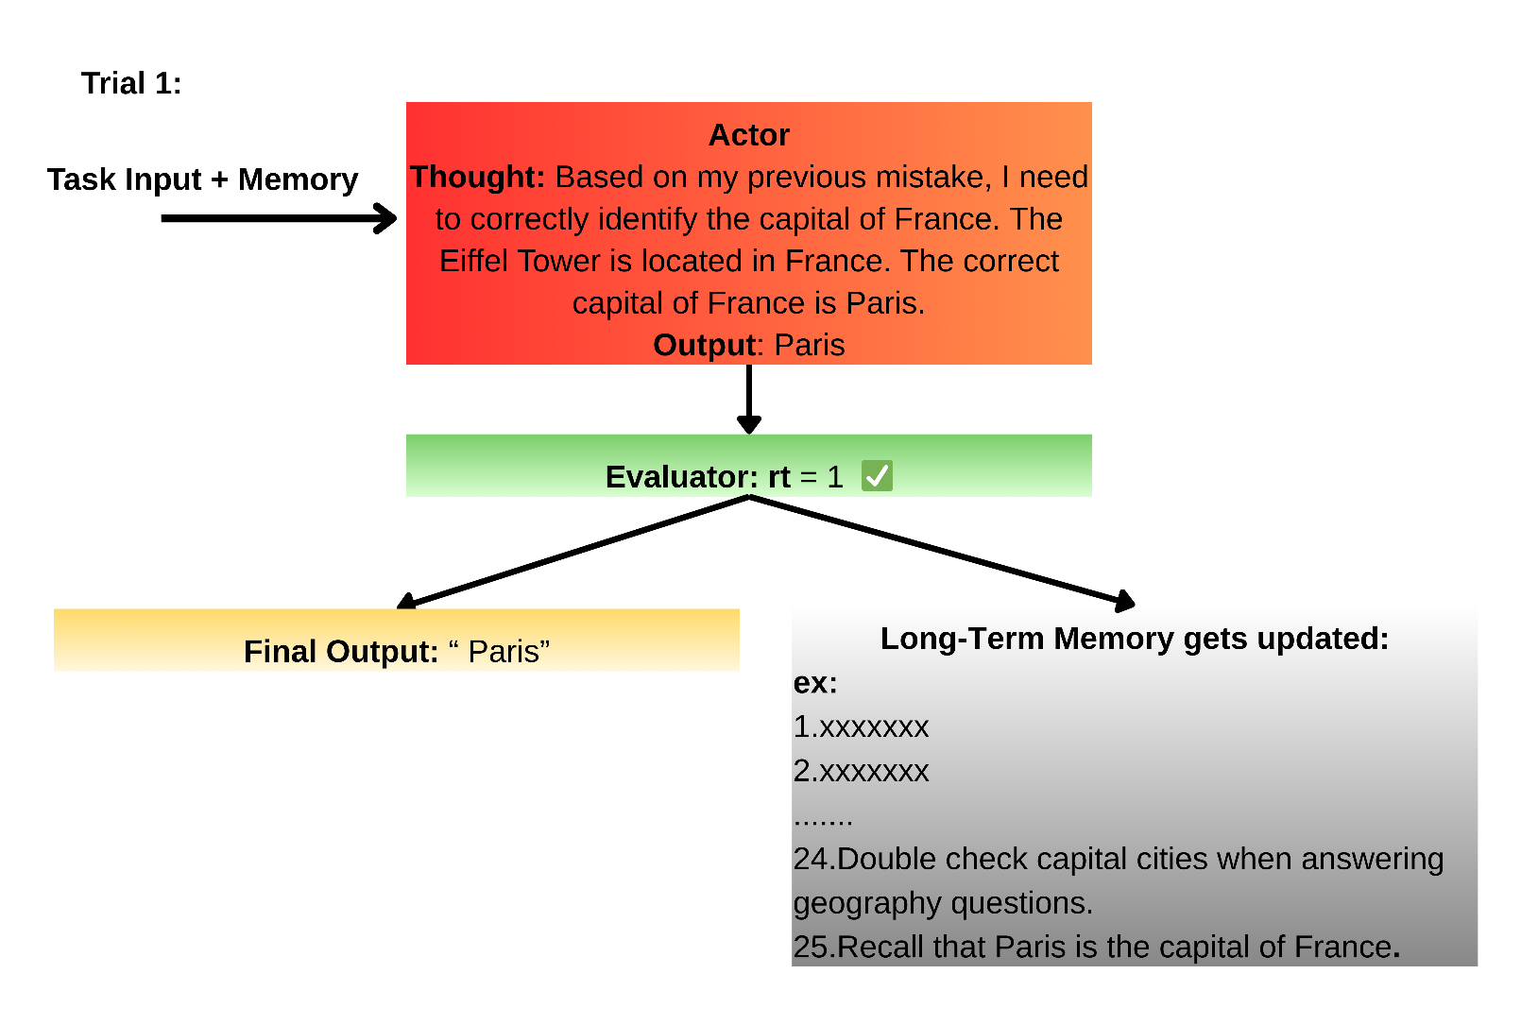

Slide 9

Evaluator
1. Reasoning Tasks: Exact Match (EM) Grading
- Binary reward: rₜ = 1 if answer exactly matches ground truth, else 0
2.Decision making task: Predefined Heuristic Functions
-Task-specific logic to detect poor planning or action repetition
3. Programming Tasks: Unit Tests
-Agent creates unit tests, Tests must pass for rₜ = 1
4. LLM as Evaluator :
- Another instance of an LLM used to interpret and critique outputs

Slide 10
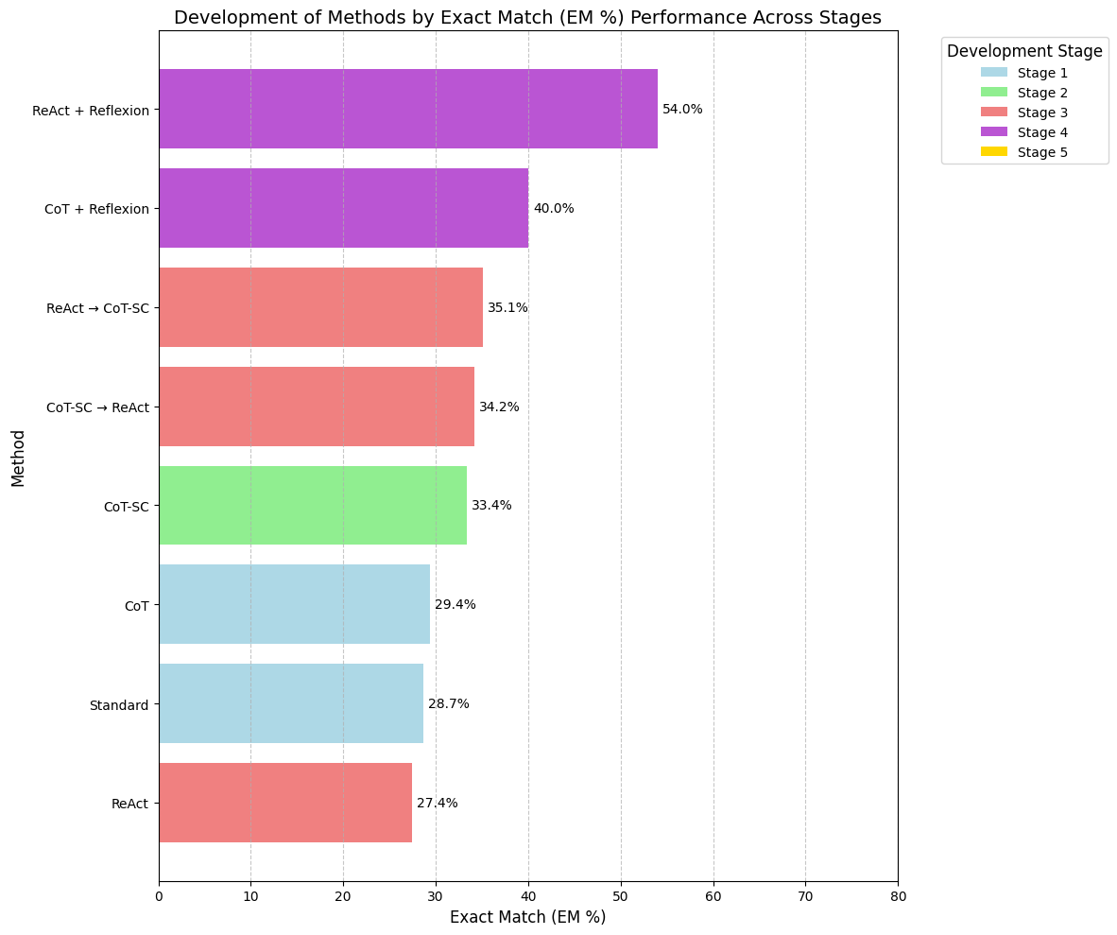
Development in Methodologies: Dataset: HotpotQA Model:PaLM-540B
ReAct (Yao, S. et al. (2023)), Reflexion (Shinn, N. et al. (2023))

Slide 11
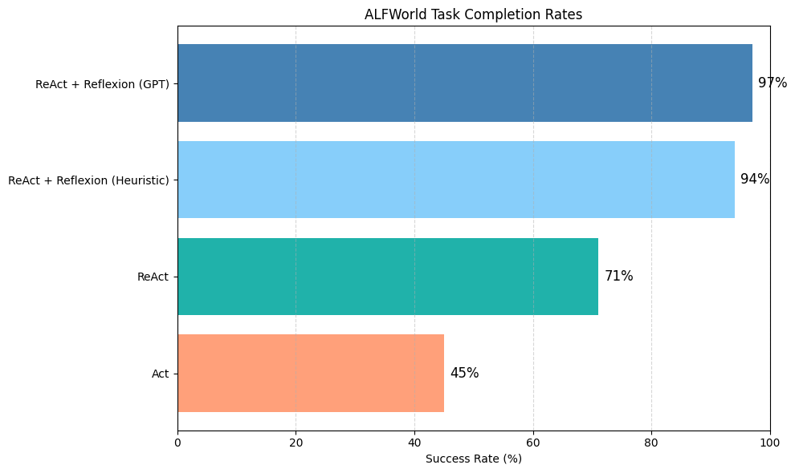
Development in Methodologies: Dataset: AlfWorld Model:GPT-3
ReAct (Yao, S. et al. (2023)), Reflexion (Shinn, N. et al. (2023))

